Slide 1
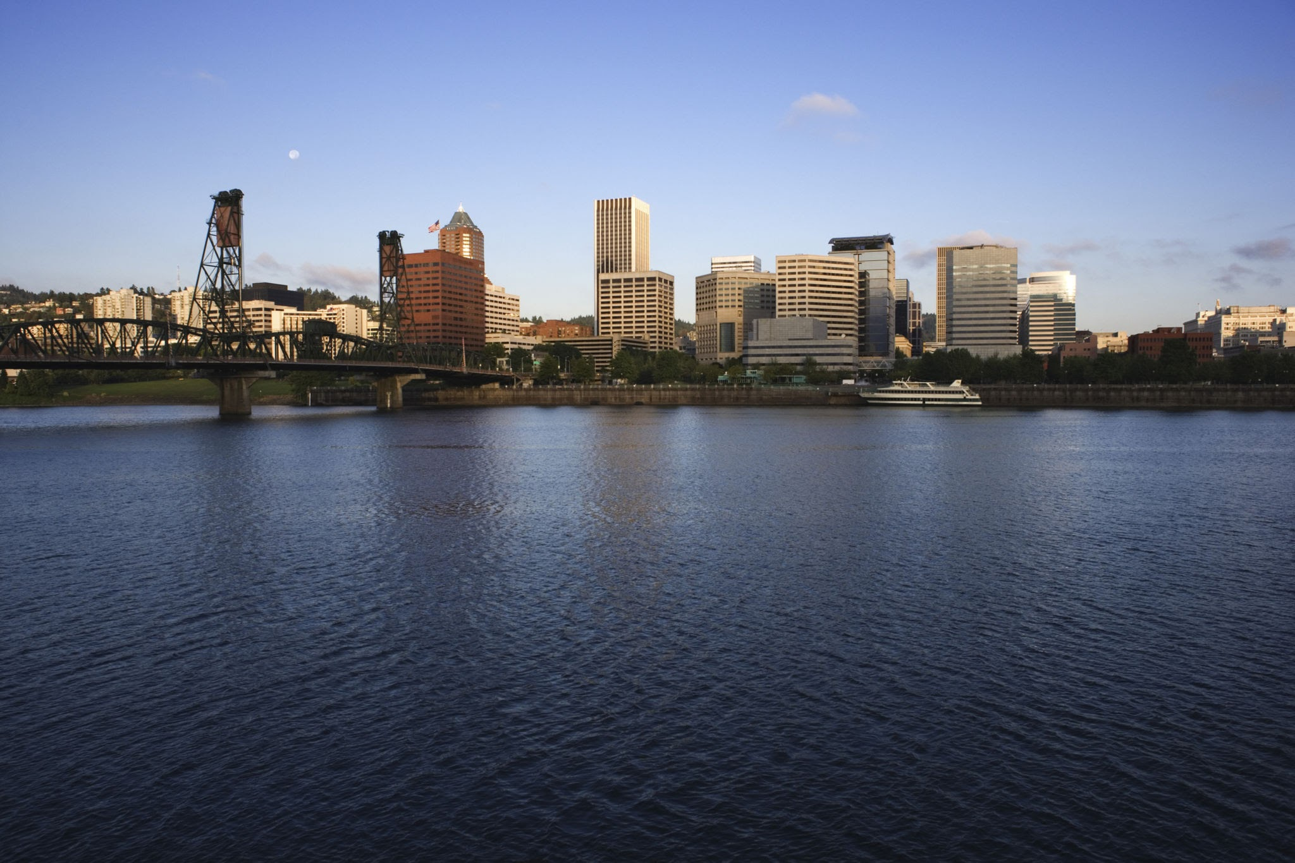
Green Infrastructure in Portland: Green Washing or Sustainable Practice?
By: Nick Beegle & Sean Pearson

Slide 2
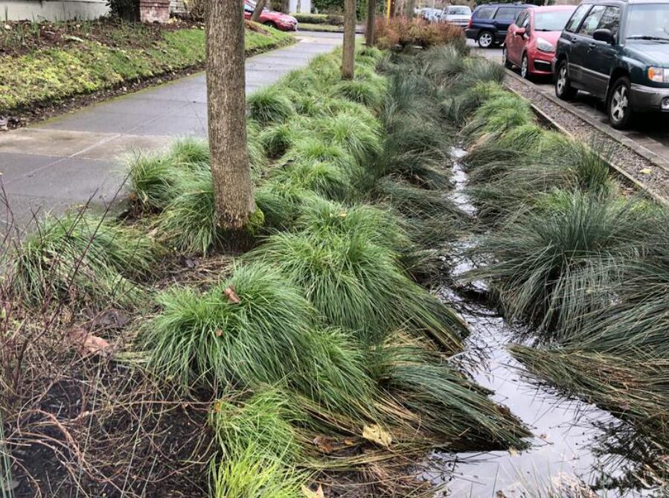
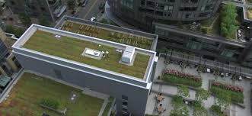
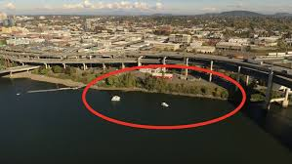
Section
12
What is Green Infrastructure?
A network of natural or semi-natural water management systems designed to provide environmental, social, and economic benefits.
Examples in Portland:
Bioswales
Eco-roofs
Mitigation Banks

Slide 3
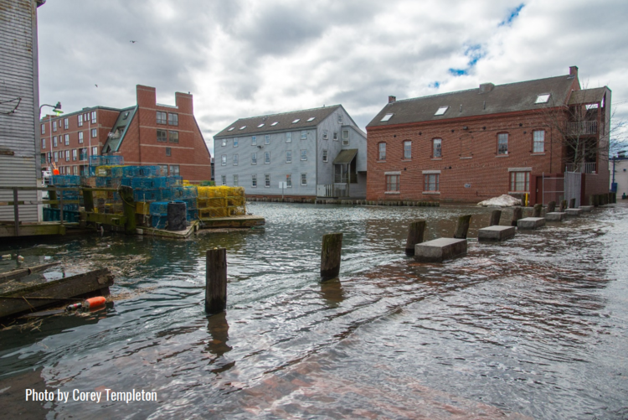
One Reason Green Infrastructure Important!
Reduces Flood Risks
Portland is bordered by two rivers, the Columbia and Willamette.
56.7% of properties are considered high risk for flooding within 30 years.
An increase in Green Infrastructure increases permeable surfaces, storing & slowing water.

Slide 4
Portland Green Infrastructure History
2003
2006
2016
Green Streets Pilot
GS Phase 2
410 Eco-Roofs Created
Policy Passed
1,927 Bioswales Created
GS Phase 1
Production Plan
Product Delivered
2005
2007
2017

Slide 5
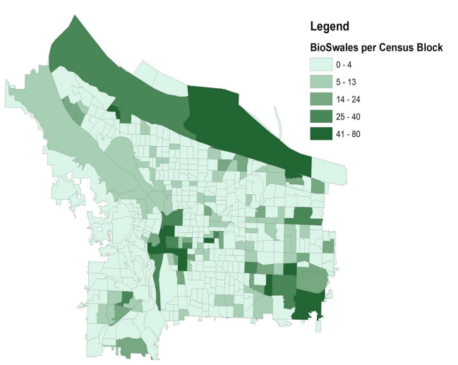

Slide 6
Research Goals
Investigate whether green infrastructure has reduced how quickly water moves through the environment by comparing hydrological data before and after widespread GI installation in Portland.
Our Approach:
Compare streamflow and precipitation before (2003) and after (2023).
Use flashiness metrics to detect changes.
Consider rainfall intensity and land cover.

Slide 7
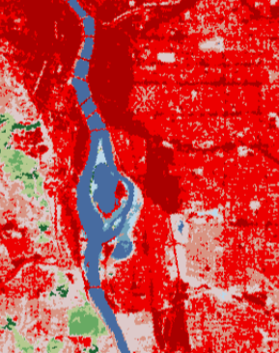
Has Green Infrastructure Impacted Impervious land in Portland?
Within our AOI:
Before GI: 50.54107
After GI: 50.46942
Average: -0.1417666
There was a decrease in impervious land within the AOI.
We believe this to be due to Portland already being fully developed in 2003 and although there are many instances of GI, they are quite small.

Slide 8
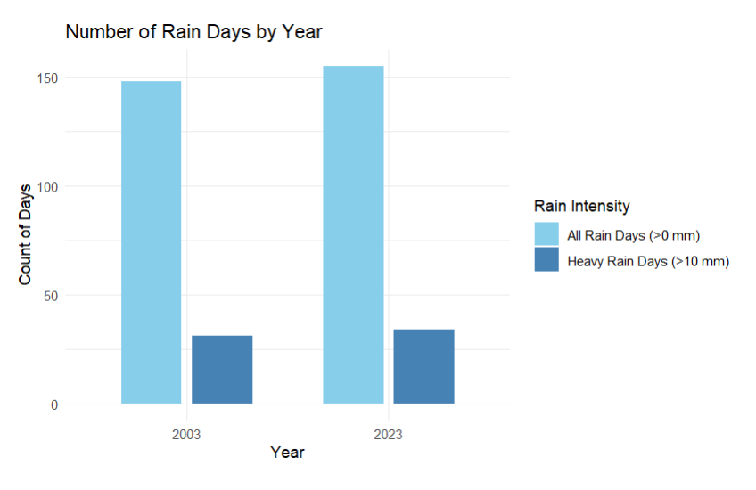
Precipitation Data

Slide 9
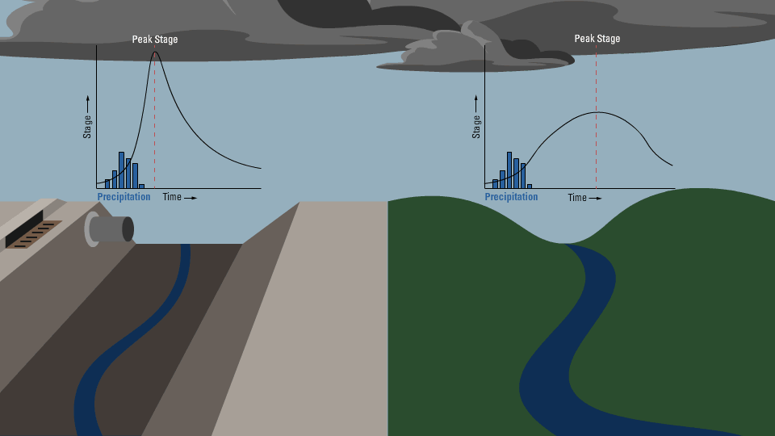
Stream Flashiness
What is it?
Flashiness is determined by how quickly water levels peak after a rain event, and how quickly water levels fall after the peak.
Can be calculated with using the Richard-Baker Index equation

Slide 10
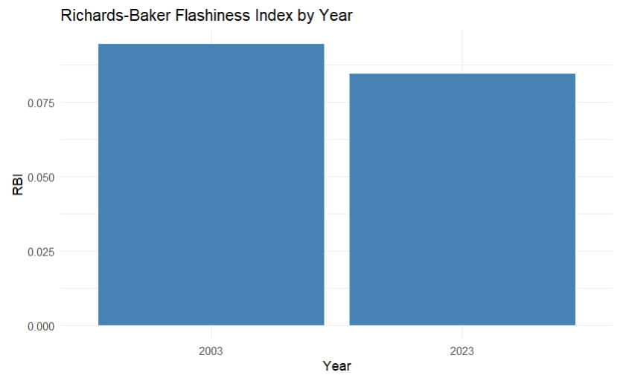

Slide 11
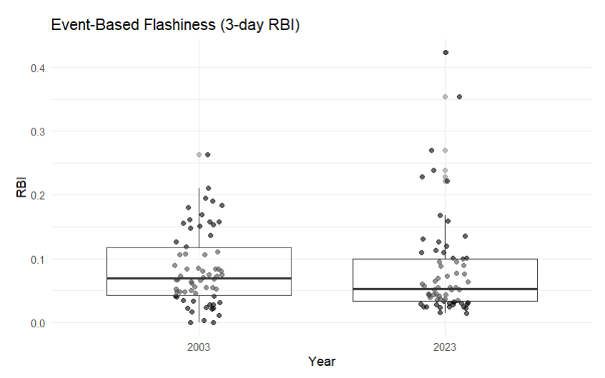

Slide 12
Is Green Infrastructure Effective
Partially:
Average stream flashiness decreased.
But extreme runoff events occurred after installation - meaning GI may not fully mitigate heavy rainfall events.
Challenges We Faced:
Our gauge was near the confluence with the Columbia River so our AOI was nested in a much larger watershed.
Many factors can affect flashiness.
Why it’s still worth it:
Provides flood risk reduction, even if it is modest.
Adds green space which improves urban livability and supports biodiversity.

Slide 13
Sources
Reed College Environmental Studies Program. (2018). Green Infrastructure Distribution in Portland, Oregon (Final report). https://www.reed.edu/es/assets/ES300-2018-project-Green-Infrastructure-Distribution-FINAL.pdf
City of Portland Bureau of Environmental Services. (n.d.). About Green Streets. https://www.portland.gov/bes/stormwater/about-green-streets
U.S. Geological Survey. (n.d.). WaterWatch – Streamflow Conditions. https://waterwatch.usgs.gov/?m=real&r=or
Multi-Resolution Land Characteristics Consortium. (n.d.). Fractional Impervious Surface Data. https://www.mrlc.gov/data?f%5B0%5D=category%3AFractional%20Impervious%20Surface
U.S. Geological Survey. (n.d.). WaterWatch – Willamette River Basin. https://waterwatch.usgs.gov/new/index.php?st=willamette+river&search.x=11&search.y=7&id=wwlmap_viewer&xft=0&choose=&ssonly=1&sspopup=0&snmfb=0&mt=real&mcf=jsontile
U.S. Geological Survey & Portland Bureau of Environmental Services. (n.d.). Portland Non-USGS Stream Gages. https://or.water.usgs.gov/non-usgs/bes/

